Slide 1
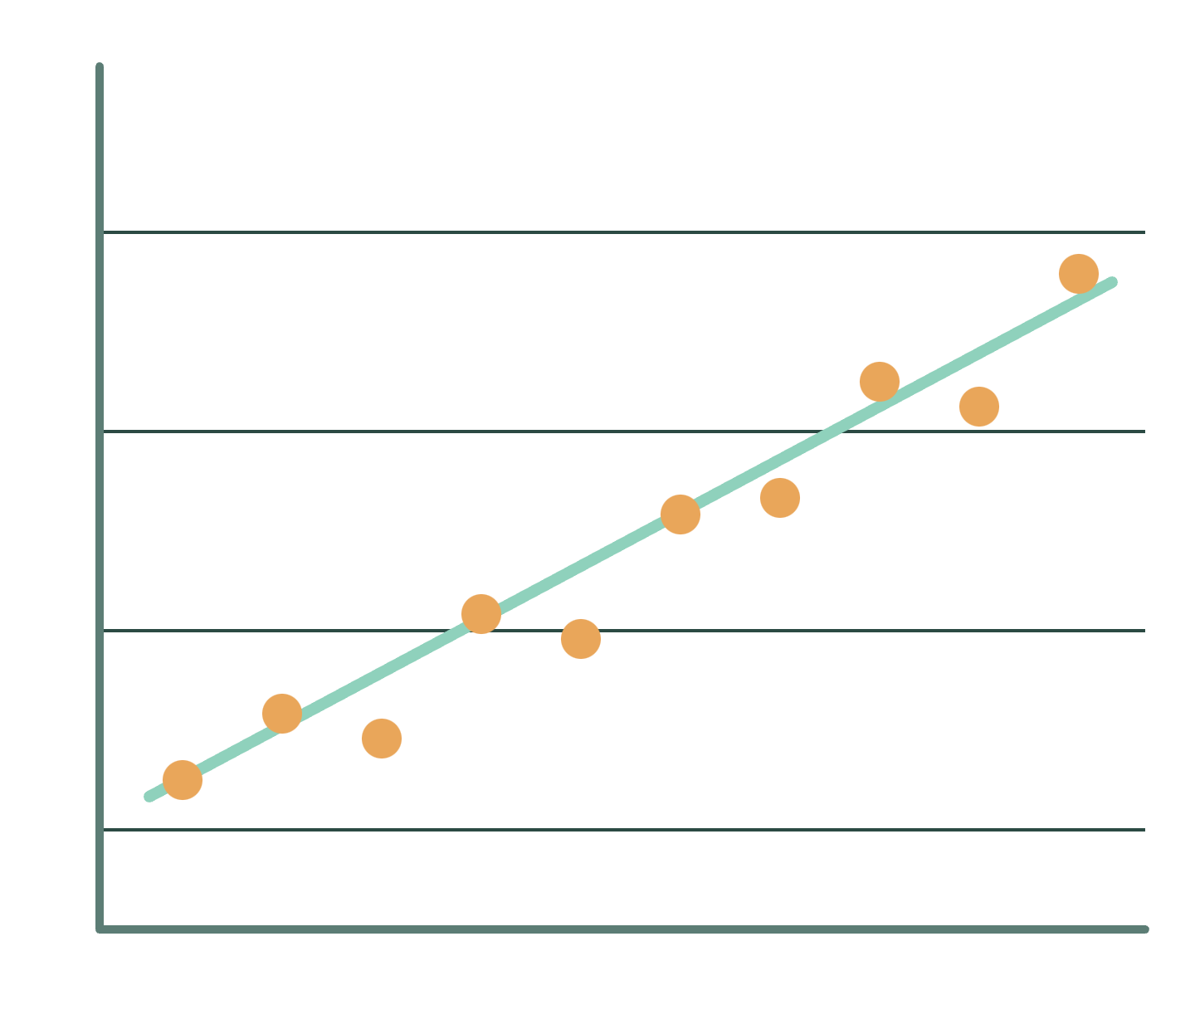
Prediction of Crop Yield using Regression Analysis
PROJECT PRESENTATION
Rainfall, cultivated area and food price index as predictors of rice yield
Based on V. Sellam and E. Poovammal, Indian Journal of Science and Technology, Vol 9(38), October 2016
Team members:
Santhiya G. - 11259A383
Renuka Devi.S. - 11259A372
Rapoorivari Pooja- 11259A365
Team Guide:
Mrs .Rajalakshmi Danprakash
Notes:
Introduce the project: we predict rice yield from rainfall, cultivated area and food price index using linear regression. Based on Sellam and Poovammal (2016).

Slide 2




Abstract
Goal: show how rainfall (AR), cultivated area (AUC) and food price index (FPI) shape rice yield.
3
1
factors: AR, AUC, FPI
crop studied: rice
Method: linear regression, with yield as the response variable.
Result: yield depends mainly on rainfall; area and price also influence it.
~10
0.72
Next: extend with MSP, CPI and WPI.
years of data
R² for rainfall and area
Prediction of Crop Yield using Regression Analysis
2
Notes:
The paper studies three factors that influence rice yield and uses linear regression to measure each one. R² values are 0.72 for rainfall and area and 0.66 for food price index.

Slide 3
Introduction
Agriculture's share of national income (%)
Agriculture is a vital source of livelihood and employment in India.
54
49
47
Its share of national income fell from 54% in 1950–51 to 31% in 1990–91.
36
31
Weather uncertainty, soil nutrients, fertilizer cost and pests make yield hard to predict.
Regression analysis can relate yield to rainfall, area and price.
1950–51
1960–61
1970–71
1980–81
1990–91
Source: Food and Agricultural Organization (2000)
Prediction of Crop Yield using Regression Analysis
3
Notes:
Agriculture's share of national income has fallen, but it is still the broadest economic sector. Yield prediction helps farmers cope with uncertainty. Chart values are from Table 1 of the paper.

Slide 4


Objective
Analyze how Annual Rainfall (AR), Area under Cultivation (AUC) and Food Price Index (FPI) affect crop yield.
Establish the relationship among these parameters using regression analysis.
Help farmers reduce losses and get better prices for their crops.
Use rice as the case study, the most common crop in many areas of India.
Predict rice yield from AR, AUC and FPI
Prediction of Crop Yield using Regression Analysis
4
Notes:
The aim is to quantify how rainfall, cultivated area and food price index influence yield, so farmers and planners can anticipate output.

Slide 5






Existing System
Yield is estimated from experience and seasonal guesswork.
Weather uncertainty
Weather, soil nutrients, fertilizer cost and pests lower output unpredictably.
Yield?
Soil and pests
Earlier studies use pattern classification (k-means, SVM) and cropping-zone indices (RSI, RYI).
hard to predict
Little quantified view of how rainfall, area and price drive rice yield together.
Market price swings
Prediction of Crop Yield using Regression Analysis
5
Notes:
This slide frames the problem the paper starts from: many uncertain factors and no simple quantified link to yield. Pattern classification and zoning methods are cited in the paper's literature review.

Slide 6



Proposed System
AR
Linear regression of rice yield on rainfall (AR), area (AUC) and food price index (FPI), one factor at a time.
Rainfall
Built in MATLAB with a degree-1 polyfit and checked with R².
AUC
Linear regression
Rice yield
Four stages: build the model, compute residuals, compute residual sum of squares and R², then implement on the data.
Area
polyfit, degree 1
R² check
An R² above 0.5 is read as a strong link to yield.
FPI
Food price
Prediction of Crop Yield using Regression Analysis
6
Notes:
Each factor is regressed against yield separately, three times in total. The model's conditions are linearity, nearly normal residuals and constant variability.

Slide 7



Proposed System: Reference Papers
1
Mucherino et al. (2009): survey of data mining techniques in agriculture
2
Kokilavani & Geethalakshmi (2013): efficient rice, maize and groundnut cropping zones in Tamil Nadu
Data mining surveys
3
Chinchuluun & Xanthopoulos (2010): data mining in agricultural and environmental sciences
Refs 1, 3, 5, 6, 7, 8
4
Suraparaju et al. (2014): machine learning to forecast crop yield from climatic parameters
Yield and zone studies
Proposed
5
Patel & Patel (2014): brief survey of data mining on agricultural data
system
6
Kumar & Kannathasan (2011): survey of data mining for soil data
Refs 2, 4, 9
7
Kalpana, Shanthi & Arumugam (2014): survey of data mining in agriculture
8
Mankar & Burange (2014): data mining, an evolutionary view of agriculture
Regression theory
9
Ramesh & Vishnu Vardhan (2013): data mining on agricultural yield data
Ref 10
10
Hair et al. (2006): Multivariate Data Analysis, 6th ed., the source for linear regression
Prediction of Crop Yield using Regression Analysis
7
Notes:
These are the ten references listed in the paper. Group labels in the drawing are based on the reference titles; the paper itself cites reference 1 for pattern classification (k-means, SVM), reference 2 for cropping zones (RSI, RYI) and reference 10 for linear regression.

Slide 8


Reference Papers vs Proposed System
Aspect | Reference papers | Proposed system
Focus | Data mining in agriculture, cropping zones, climate-based forecasting | Rice yield against rainfall, area and food price
Methods | Classification, clustering, machine learning (k-means, SVM) | Linear regression, one factor at a time
Output | Surveys, zone indices, forecasts | R² for each factor
Ease of use | Often heavier models | Simple and easy to explain
10 reference papers
broad methods and many crops
Regression idea
Hair et al. (2006)
Proposed system
Prediction of Crop Yield using Regression Analysis
8
Notes:
This comparison is based on the titles of the ten references and on how the paper cites them (k-means and SVM from the classification work, RSI and RYI from the cropping-zone work, linear regression from Hair et al.). Check the original reference papers before quoting specifics about their results.

Slide 9
Existing vs Proposed System
R² of each factor vs rice yield
Aspect | Existing system | Proposed system
Basis | Experience, classification, zoning | Regression on AR, AUC, FPI
Factors | Examined in isolation | Rainfall, area and price together
Output | Descriptive, zone-level | Quantified with R² per factor
Insight | Harder to interpret | Easy to read and explain
AR
0.72
AUC
0.72
FPI
0.66
Dashed line: R² of 0.5, the paper's threshold for a strong relationship
Prediction of Crop Yield using Regression Analysis
9
Notes:
The comparison table is a summary of the approaches, not a benchmark from the paper. The bar chart shows the paper's R² results (Figures 1 to 3).

Slide 10

Advantages
Simple linear model that is easy to explain.
Measures each factor's strength with R²: AR 0.72, AUC 0.72, FPI 0.66.
Needs only public data from the Dept. of Statistics and Agriculture, NIC.
Quick to run in MATLAB and easy to extend with more factors.
Each factor shows a clear link to yield
Prediction of Crop Yield using Regression Analysis
10
Notes:
The illustration is decorative; the numbers come from the paper's Figures 1 to 3. Table 2 data is sourced from the Department of Statistics and Agriculture, National Informatic Centre.

Slide 11
Disadvantages
Included in this study
Only three factors; soil, weather and support price are left out.
AR
AUC
FPI
Rainfall
Area
Food price
Only rice is studied, so results may not carry over to other crops.
Not yet included
A straight-line model can miss non-linear effects.
Soil
Weather
MSP
R² shows association, not cause.
Parameters
Conditions
Support price
Future work named in the paper: MSP, weather conditions, soil parameters
Prediction of Crop Yield using Regression Analysis
11
Notes:
The paper itself lists MSP, CPI, WPI, weather conditions and soil parameters as factors to add later.

Slide 12
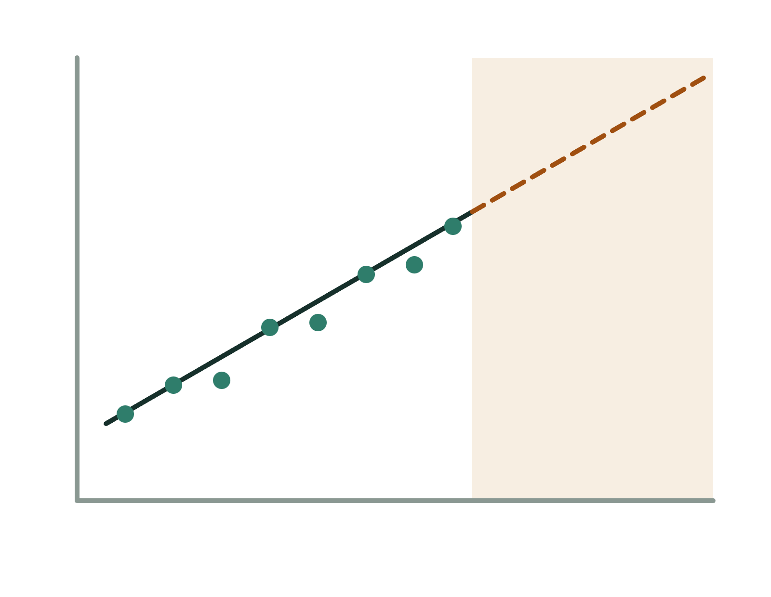
Limitations
Small sample: about ten years of rice data (Table 2).
Irrigation figures are missing (NA) for 2008–09 to 2010–11.
R² is the only accuracy measure reported; no separate test data.
Predicting outside the data range is extrapolation and less reliable.
Observed data
Extrapolation, less reliable
Prediction of Crop Yield using Regression Analysis
12
Notes:
Be ready for two questions. The abstract states the period as 1990-2000, but Table 2 covers 2000-01 to 2010-11. Figure 1 prints R² as 0.7232 while the text says 0.7242. The deck uses the rounded value 0.72 for both rainfall and area.

Slide 13

Conclusion
Rainfall (AR)
Rainfall, area and food price index each show a strong link to rice yield (R² 0.66 to 0.72).
Area (AUC)
Rainfall stands out as the main driver, with area and price also influencing yield.
Food price (FPI)
Regression gives a simple, interpretable base for yield prediction.
Next: add MSP, CPI, WPI, weather and soil factors.
Rice yield
Relationship chain shown in the paper's Figure 4
Prediction of Crop Yield using Regression Analysis
13
Notes:
Close on the main message: simple regression already shows strong links between rainfall, area, price and rice yield, and the paper points to more factors and data-mining methods as the next step.

